Slide 1

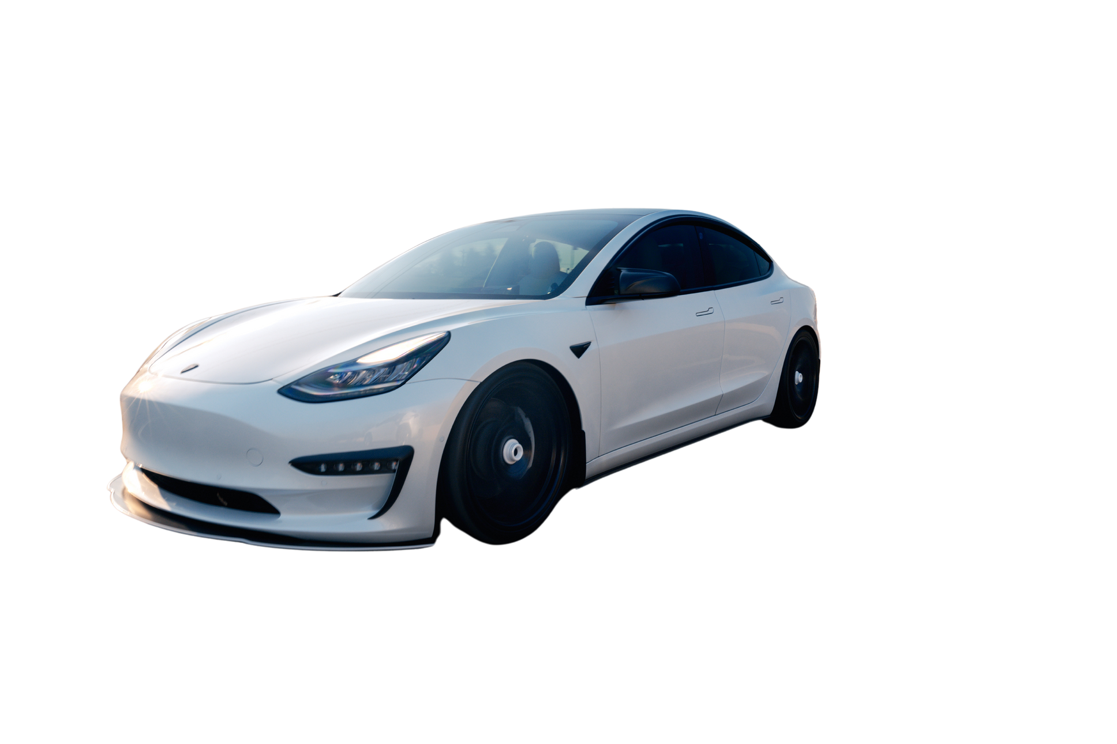

REAL-TIME OBJECT DETECTION
FOR
AUTONOMOUS VEHICLES

Slide 2
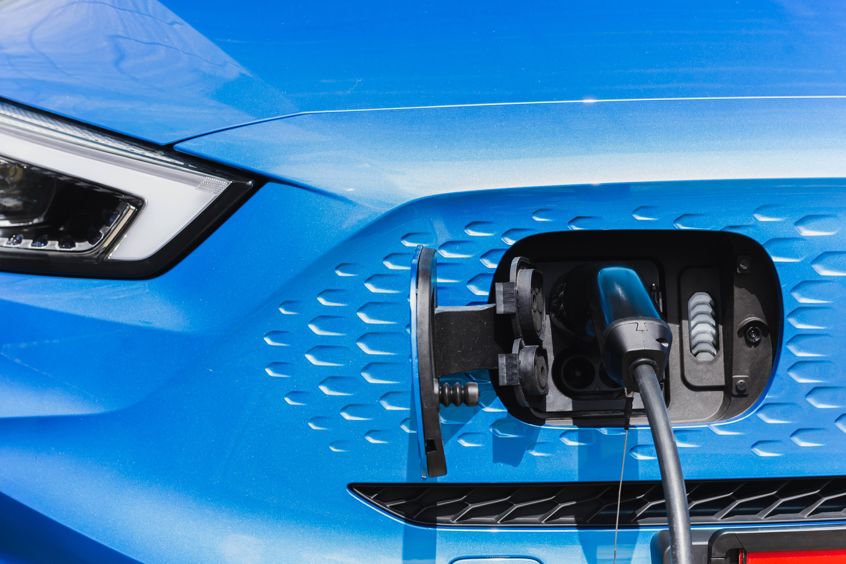
PROJECT OVERVIEW
OBJECTIVE:
Develop a real-time object detection system for autonomous driving.
KEY FEATURES:
Detect pedestrians, vehicles, traffic signs, traffic lights, and potholes.
Real-time performance under diverse environments
Scalable deployment and monitoring with MLOps

Slide 3



PROBLEM STATEMENT
AUTONOMOUS VEHICLES NEED:
Accurate object detection in real-time
Robustness in varying weather, lighting, and road conditions
CHALLENGES
DEPLOYMENT COMPLEXITY
ENVIRONMENTAL ADAPTATION
CLASS IMBALANCE

Slide 4

DATASETS USED
KITTI – PRIMARY DATASET FOR VECHILES AND PEDESTRIAN DETECTION
S2TLD – PRIMARY DATA FOR TRAFFIC LIGHTS DETECTION
APID – PRIMARY DATA FOR POTHOLE DETECTION
ITSD – PRIMARY DATA FOR TRAFFIC SIGN DETECTION
EXPLORATION SUMMARY:
Multiple classes (cars, pedestrians, road signs)
Varying lighting/weather conditions
Augmentation for realism (flipping, brightness, rotations)

Slide 5
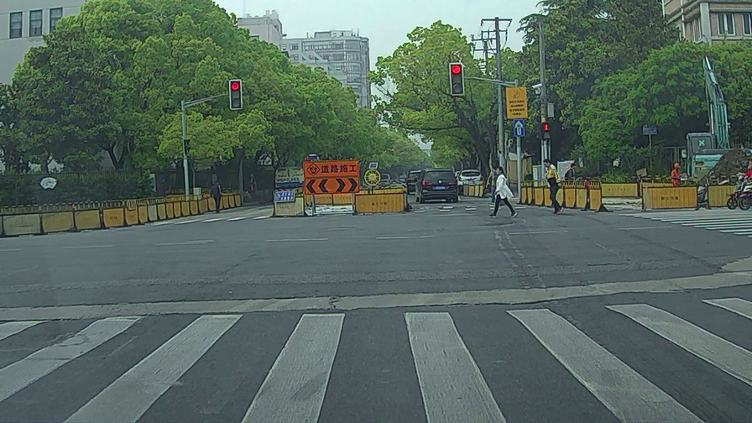
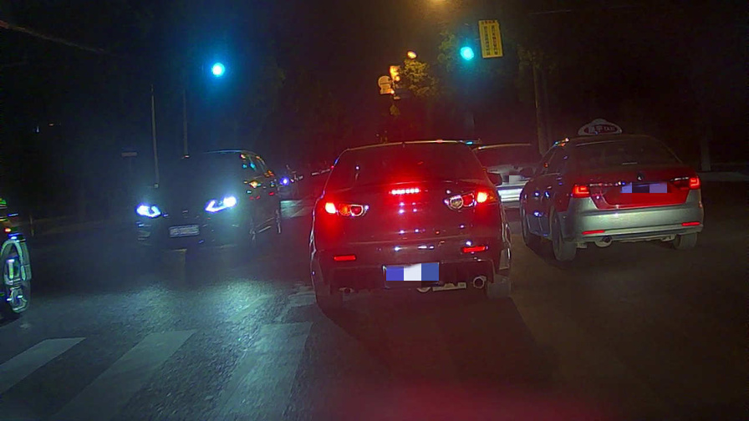
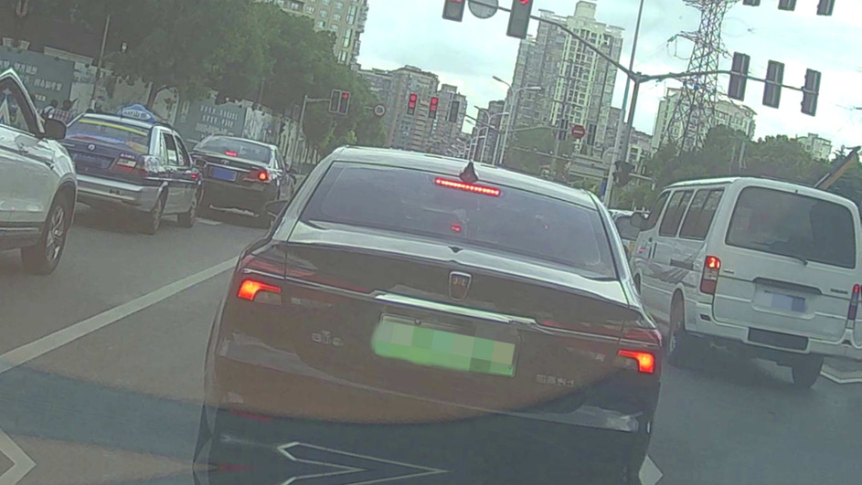
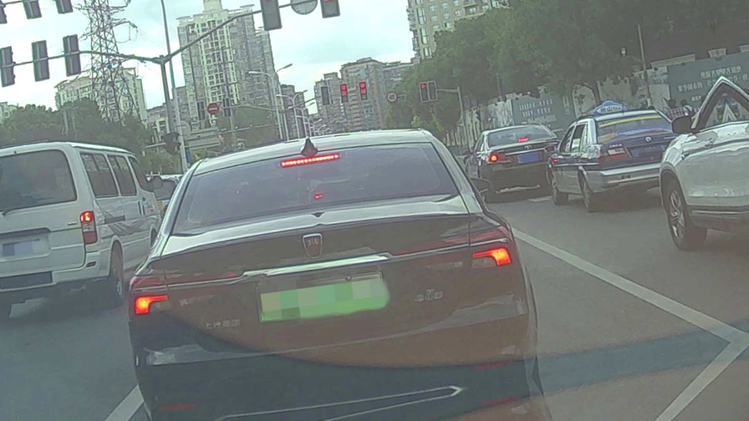
EXAMPLE ON LIGHTING CONDITIONS:
EXAMPLE ON AUGMENTATION:

Slide 6
MODEL SELECTION
YOLOV8 & YOLOV11
REASON:
efficient for real time detection
KEY FEATURES OF YOLOV8:
ADVANCED BACKBONE AND NECK ARCHITECTURES: YOLO EMPLOYS STATE-OF-THE-ART BACKBONE AND NECK ARCHITECTURES, RESULTING IN IMPROVED FEATURE EXTRACTION AND OBJECT DETECTION PERFORMANCE.
OPTIMIZED ACCURACY-SPEED TRADEOFF: WITH A FOCUS ON MAINTAINING AN OPTIMAL BALANCE BETWEEN ACCURACY AND SPEED, YOLOV8 IS SUITABLE FOR REAL-TIME OBJECT DETECTION TASKS IN DIVERSE APPLICATION AREAS.
VARIETY OF PRE-TRAINED MODELS: YOLOV8 OFFERS A RANGE OF PRE-TRAINED MODELS TO CATER TO VARIOUS TASKS AND PERFORMANCE REQUIREMENTS, MAKING IT EASIER TO FIND THE RIGHT MODEL FOR YOUR SPECIFIC USE CASE.

Slide 7
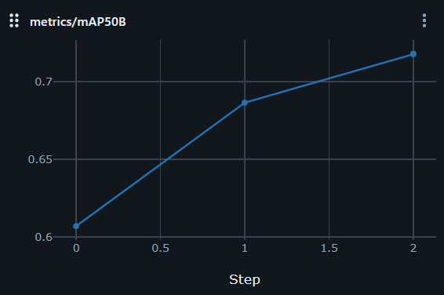
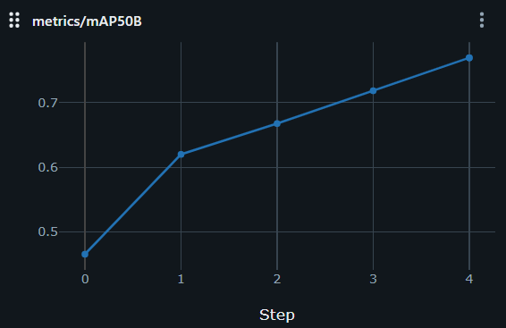
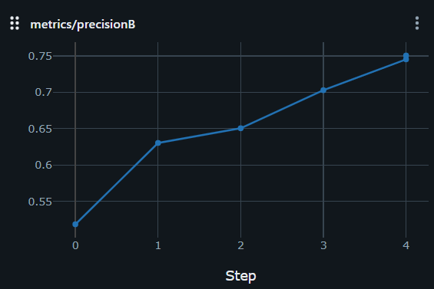
MODEL TRAINING & EVALUATION
MAP50B (TRFFIC_LIGHT)
TRANSFER LEARNING
TRANSFER LEARNING: USED PRE-TRAINED WEIGHTS FROM COCO
FINE-TUNING
METRICS ACHIEVED
PRECISION (KITTI)
FINE-TUNING: ON KITTI AND RELEVANT DATASETS
AVERAGE METRICS ACHIEVED:
MAP50B: ~ 75%
BOX LOSS: ~ 1
CLS LOSS: ~ 1.2
PRECISION: ~85%

Slide 8

DEPLOYMENT PIPELINE
FRAMEWORKS: YOLOV8 + YOLOV11 + OPENCV
DEPLOYMENT: STREAMLIT-BASED SERVICE WITH MULTIPLE INPUT OPTIONS
INTEGRATION: REAL-TIME DETECTION ON VEHICLE FEED
MLOPS & MONITORING: EXPERIMENT TRACKING AND PERFORMANCE MONITORING WITH MLFLOW

Slide 9
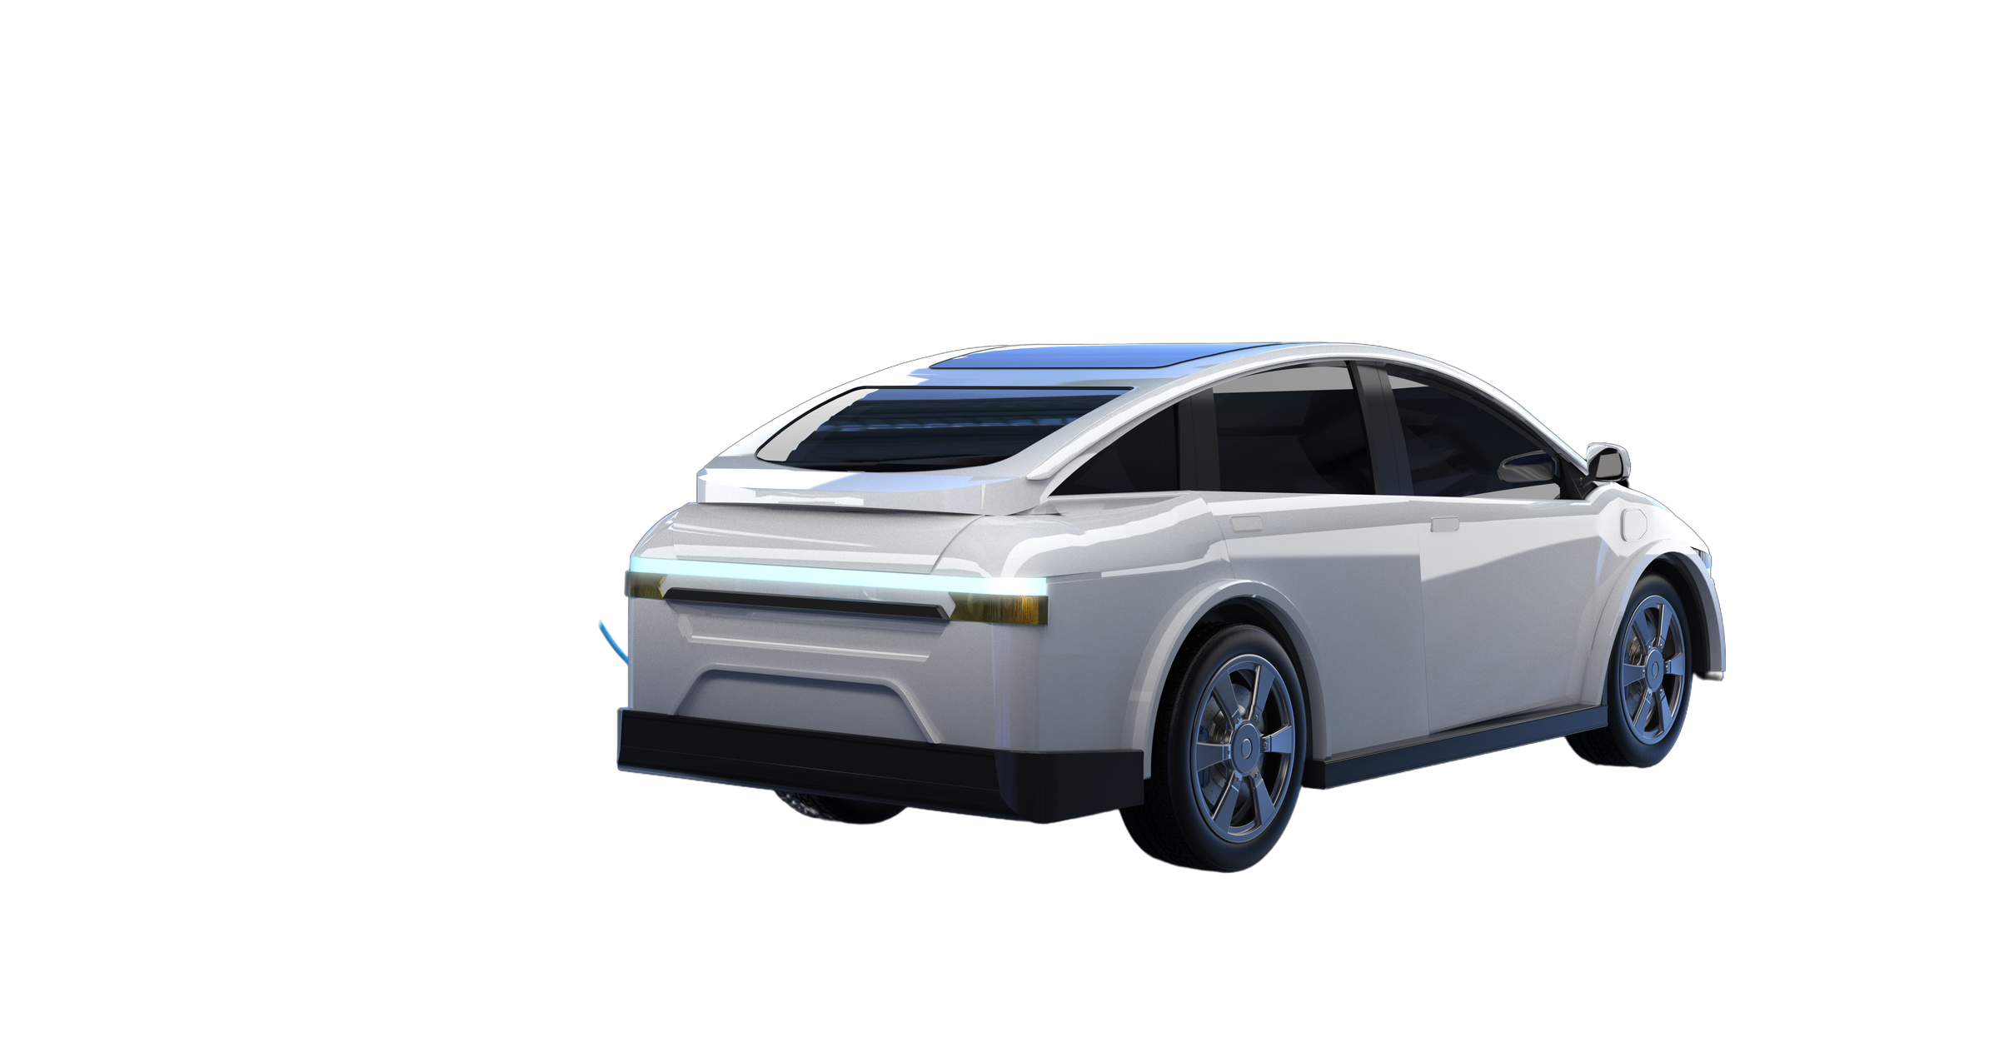
REAL-WORLD TESTING
TEST CONDITIONS
LOW LIGHT
HIGHWAY
URBAN
PERFORMANCE:
STABLE DETECTION ACROSS ENVIRONMENTS
MINOR PERFORMANCE DROP IN FOGGY ENVIROMENTS (IMPROVED WITH RETRAINING)

Slide 10
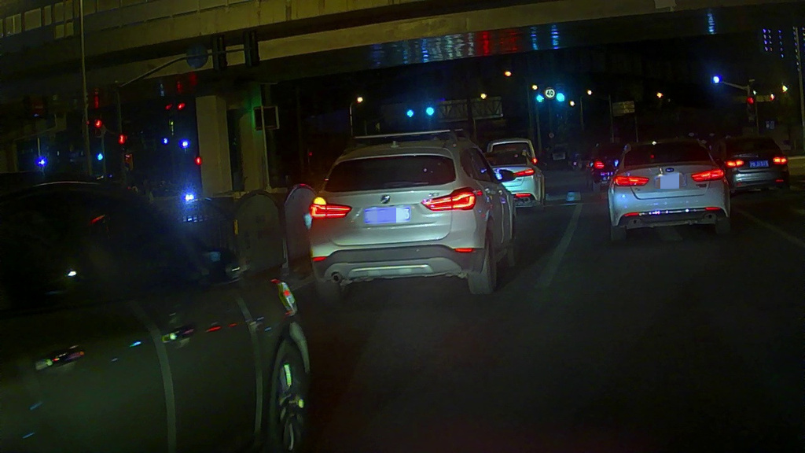
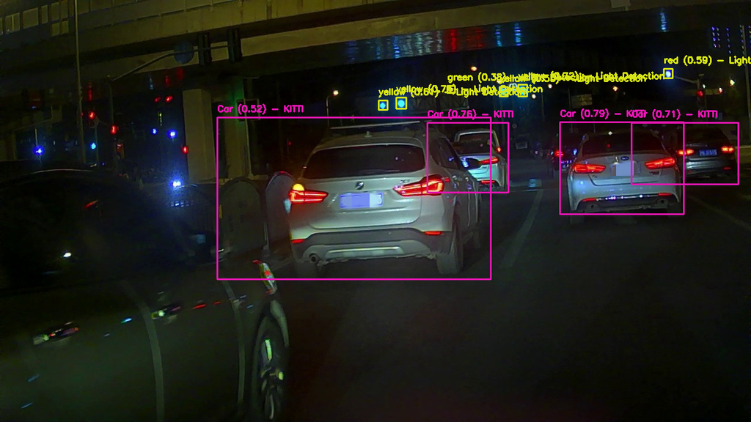
EXAMPLE ON LOW LIGHT TEST CASE:

Slide 11

CHALLENGES & SOLUTIONS
CHALLENGE
LOW LIGHT DETECTION
CLASS IMBALANCE
DEPLOYMENT COMPLEXITY
SoLUTION
AUGMENTATION
OVERSAMPLING + CLASS WEIGHTING
MULTI-MODEL INFERENCE PIPELINE

Slide 12

MLOPS & MONITORING WITH MLFLOW
FEATURES:
EXPERIMENT TRACKING
PERFORMANCE MONITORING
OPTIMAL TRAINING

Slide 13

FINAL OUTCOMES
REAL-TIME OBJECT DETECTION MODEL DEPLOYED
STRONG ACCURACY (MAP50B > 75%) AND FAST INFERENCE
SCALABLE SYSTEM WITH MONITORING AND RETRAINING CAPABILITIES
READY FOR REAL-WORLD AUTONOMOUS VEHICLE APPLICATIONS

Slide 14

FUTURE WORK
ADD OBJECT TRACKING (DEEP SORT)
SENSOR FUSION (LIDAR + CAMERA)
MORE CLASSES (E.G., ROAD CONDITIONS, ANIMALS)
MORE DATA AUGMENTATION TO FIT MORE ENVIROMENTS AND CROPPED CLASSES
ADAPTING THE SYSTEM FOR DEPLOYMENT ON EDGE DEVICES
CONNECTING REAL-TIME DETECTIONS TO SMART CITY INFRASTRUCTURES FOR TRAFFIC MONITORING AND INCIDENT DETECTION.

Slide 15

DEMO / VIDEO

Slide 16
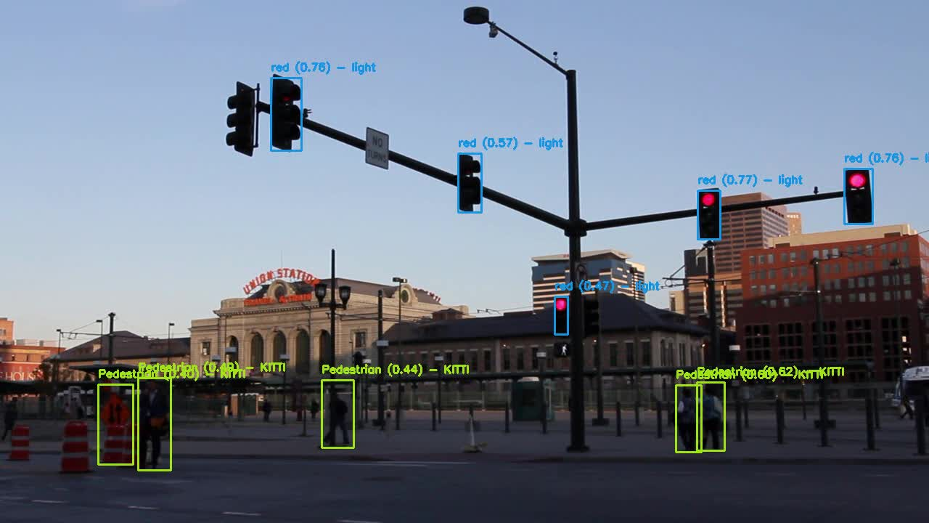
DEMO / VIDEO

Slide 17
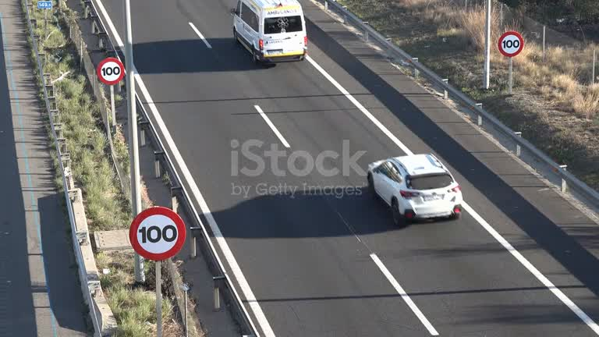
DEMO / VIDEO

Slide 18
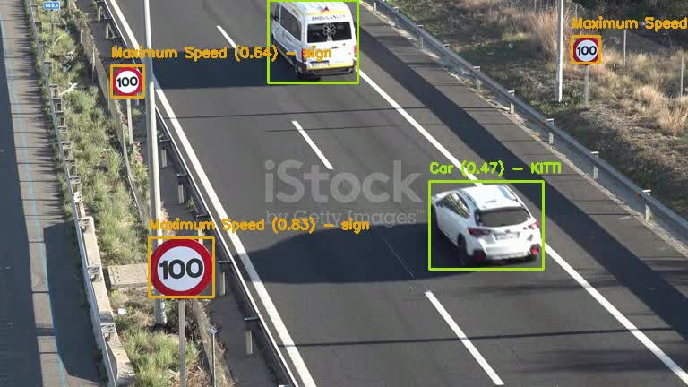
DEMO / VIDEO

Slide 19
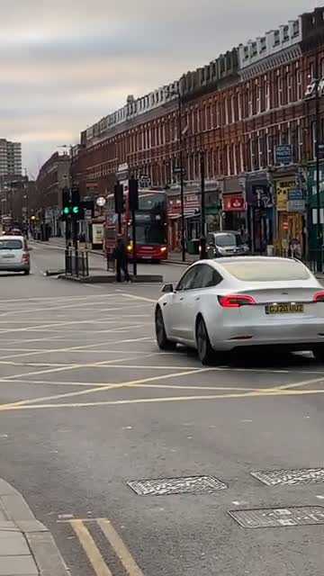
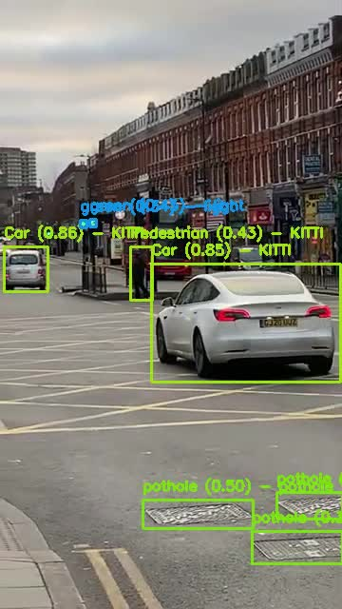

DEMO / VIDEO

Slide 20

CONCLUSION
REINFORCED THE IMPORTANCE OF REAL-TIME DETECTION IN AVS
DELIVERED A COMPLETE DL SYSTEM WITH DEPLOYMENT AND MLOPS
CONTRIBUTED TO SAFER, MORE RELIABLE AUTONOMOUS DRIVING

Slide 21
THANK YOU
PRESENTED BY:
MARCELENO AYMAN
THERESE SAMEH
HOSSAM EMAM
OMAR ELMAHY
YOUSSEF

